Slide 1
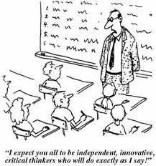
Ms. Andre Clear Lake High School 2019-2020
AVID 9
"We all have dreams. But in order to make dreams come into reality, it takes an awful lot of determination, dedication, self-discipline, and effort." -Jesse Owens
Class Rules
Welcome to Freshman AVID
Welcome to your AVID class! AVID stands for Advancement Via Individual Determination. This is an academic elective class is designed to help students develop academic skills, behaviors and attitudes necessary to succeed in high school and be successful at the college level. In the meantime, it is your responsibility to attend class regularly and complete assignments on time. It is important for you, as an AVID student, to realize that it is a privilege to be in AVID. It is not a free ride! Therefore you must work hard in order to be successful
Be respectful to yourself, your classmates and your environment
Follow directions, class procedures, and school policies
Make smart choices.
Class Expectations
Be in seat when tardy bell rings.
Put proper heading on all papers.
Do no use electronic devices in class without permission.
Use restroom during passing breaks (otherwise points will be removed from your grade)
Maintain a clean and orderly work area.
Bring all of your supplies to class daily.
Complete all work and turn it in on time.
All school rules and policies shall be observed within the classroom.
Classroom Expectation & Guidelines
As an AVID student, you are expected to behave and be a role model for other students in your classes. Therefore, you must always be punctual, respectful and productive. If a student is off task a verbal warning will occur, then a moved seat, opportunity to work outside, parent contact, and finally a referral to the Vice Principal.
Where do I go to find assignments?
Google Classroom is where many class assignments, discussions, and projects will be posted and turned in.
Class code: 4uib3ko
What happens if I turn in an assignment late?
Work not completed and turned in by the assigned date is considered late. If a student is absent on the date work is due, the assignment is due the first day the student returns to school. COMPLETED LATE WORK will only receive partial credit (70% of the assignment total). INCOMPLETE LATE WORK will not be graded and will result in a zero for the assignment.
Tardies and restroom breaks
At the beginning of each semester every student will be given 60 extra credit points. Everytime a student is tardy, or leaves the room to go to the restroom, they will lose 10 extra credit points.
nicoleandre@lakeport.k12.ca.us
Notes:
‹#›

Slide 2
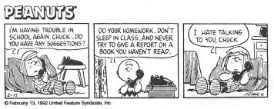
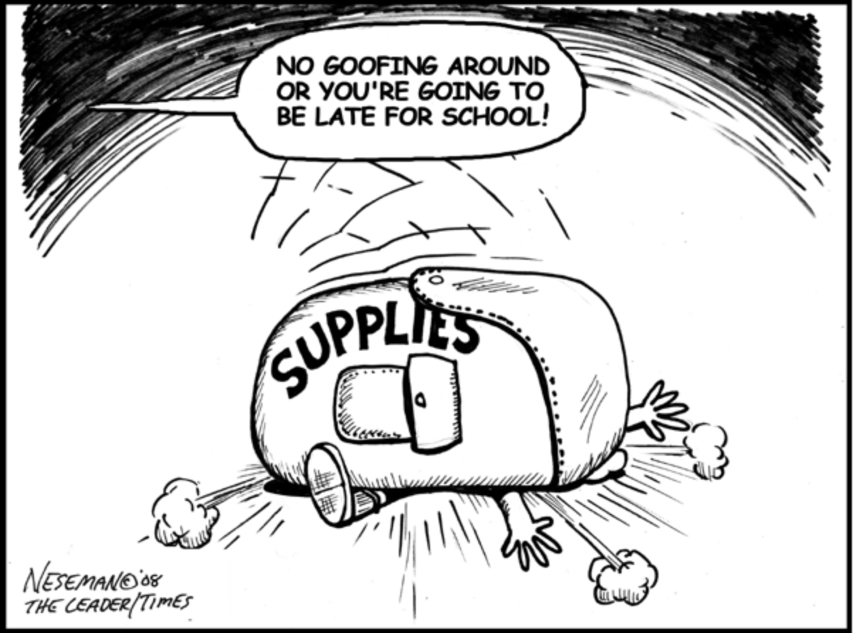
Ms. Andre Clear Lake High School 2019 - 2020
Grade Scale
Focused Notes (Cornell Notes)
Each Focused Note will be worth 5 points. I will mark off 1 point if any of the five elements is incomplete.
A+ | = 98-100% | A | = 94% - 97%
A- | = 90% - 93% | B+ | = 87% - 89%
B | = 84% - 86% | B- | = 80% - 83%
C+ | = 77% - 79% | C | = 74% - 76%
C- | = 70% - 73% | D | = 60% - 69%
F | = 0% - 59%
You are required to take Focused Notes in your
content classes. Focused Notes (Cornell Notes) is a
structured way of writing notes that emphasizes
repetition.
Studies have shown that the more repetition
you have with a text, the better you will understand it.
I will be checking Focused Notes every Friday. Focused Notes are a part of your
grade. You are required to have an essential question, highlighting or underlining and a summary to receive full credit.
WICOR
AVID is centered on four areas of study: WICOR
Writing, Inquiry (question forming and analysis), Collaboration, Organization, Reading
You will read and write expository texts while having to inquire and collaborate with classmates about ideas and various points of view.
You will participate in Socratic Seminars, where you analyze a topic and then discuss the main idea and claims of the text with your classmates.
A large part of the AVID curriculum revolves around Organization. You are required to keep a binder for all your content classes to ensure that you stay organized throughout the year
Grade Breakdown
Projects 25%
Binders/Note Checks 25%
Tutorials 25%
Home/Classwork 25%
Binder Check
Your binder enables you to be organized. When I check your binders, I will be looking for no loose papers in the front or back pockets, and all assignments should be in the correct section in chronological order (newest on top, oldest on the bottom).
Sometimes binder checks will be announced ahead of time, and other times they will be at random. Always keep your binder organized so you don’t lose points on a binder check.
Supplies
2-3 inch 3 ring binder
Dividers
College-ruled paper
Highlighters
Pencils & Pens
AVID Contract
AVID is an academic elective. All students are required to sign the contract. If at any time the contract is broken the student can be put on AVID probation and/or removed from the AVID program.
AVID Requirements are:
Maintain an AVID Binder
Maintain a 2.5 GPA
Participate in weekly tutorials
Take Focused Notes
Take a rigorous curriculum
Occasionally there will be extra credit opportunities that will be announced. PAY ATTENTION! Please do not ask for extra credit. I will not give it.
nicoleandre@lakeport.k12.ca.us

Slide 3
Clear Lake High School AVID Contract
Advancement Via Individual Determination
Name of Student:__________________________________Enrollment Date:______________
AVID is a program that prepares students for four-year college eligibility.
Student goals:
Academic success in high school/college preparatory classes.
Successful completion of high school/college eligibility requirements
Enrollment in four-year college or university after high school graduation.
Student Responsibilities:
Maintain satisfactory citizenship and attendance in all classes.
Maintain the AVID binder contents including, but not limited to, assignment sheet and Focused notes.
Complete all homework assignments
Maintain an average GPA of 2.5 of higher in all classes.
Student Agreement:
I agree to accept enrollment into the AVID elective class, which will offer academic support to me. I want to succeed and I understand I that I must take individual responsibility for my own success. I understand that in order to give fair consideration to my involvement with the program, I must commit to remaining enrolled in the AVID elective for at least one year and that I will be allowed to remain in the program only if I meet the student responsibilities outlined above. I also understand that studies show I will be most likely to demonstrate academic improvement if I remain in the program for at least three years.
Student Signature:___________________________________________________________
Support Statement: We agree to support the efforts of this student in meeting the goals outlined above.
____________________________ ____________________________
AVID Teacher Signature Parent Signature
____________________________ ____________________________
AVID Counselor Signature Site Administrator Signature:

