Slide 1
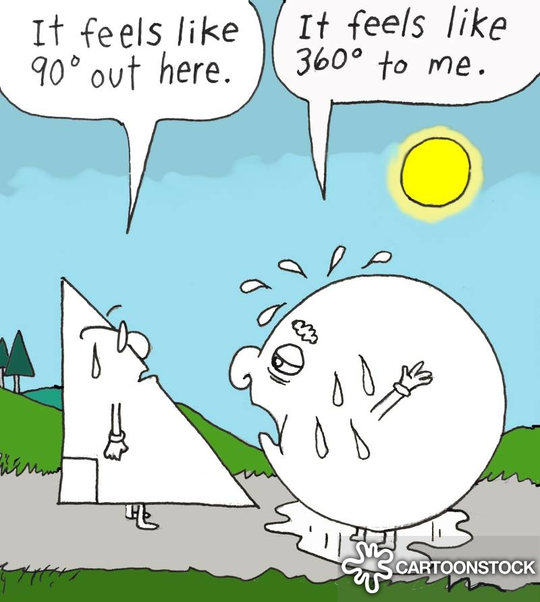
Ms. Andre Clear Lake High School 2019-2020
Geometry
“Life isn't about algebra and geometry. Learning by making mistakes and not duplicating them is what life is about.” -Lindsay Fox
Class Rules
Course Description
Be respectful to yourself, your classmates and your environment
Follow directions, class procedures, and school policies
Make smart choices.
This course is designed to emphasize the study of the properties and applications of common geometric figures in two and three dimensions. It includes the study of transformations and right triangle trigonometry. Inductive and deductive thinking skills are used in problem solving situations, and applications to the real world are stressed. It also emphasizes writing proofs to solve (prove) properties of geometric figures. Students who complete Geometry should take Algebra II next.
Class Expectations
What are the consequences if I don’t follow class rules?
Be in seat when tardy bell rings.
Put proper heading on all papers.
Do no use electronic devices in class without permission.
Use restroom during passing breaks (otherwise points will be removed from your grade)
Maintain a clean and orderly work area.
Bring all of your supplies to class daily.
Complete all work and turn it in on time.
All school rules and policies shall be observed within the classroom.
1. Warning: the teacher provides a verbal reprimand/reminder to student. .
2. Demerits: a mark recorded for poor conduct. Meet with teacher after class.
3. Detention: short time spent after school to contemplate conduct
4. Referral to Administration: a cadet will be immediately referred to
administration for severe behavior problems.
Where do I go to find agendas and assignments?
Google Classroom is where many class assignments, discussions, and projects will be posted and turned in.
Class code: zl75l00
What happens if I turn in an assignment late?
Work not completed and turned in by the assigned date is considered late. If a student is absent on the date work is due, the assignment is due the first day the student returns to school. All late work for each unit must be completed before the unit test. COMPLETED LATE WORK will only receive partial credit (70% of the assignment total). All late work for must be completed before the unit test. INCOMPLETE LATE WORK will not be graded and will result in a zero for the assignment.
What happens if I’m tardy or need to use the restroom?
At the beginning of each semester every student will be given 60 extra credit points. Everytime a student is tardy, or leaves the room to go to the restroom, they will lose 10 extra credit points.
nicoleandre@lakeport.k12.ca.us
Notes:
‹#›

Slide 2
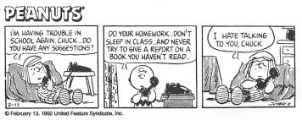
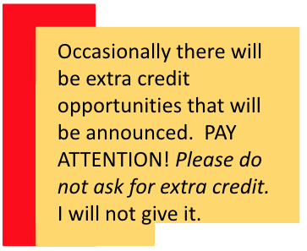
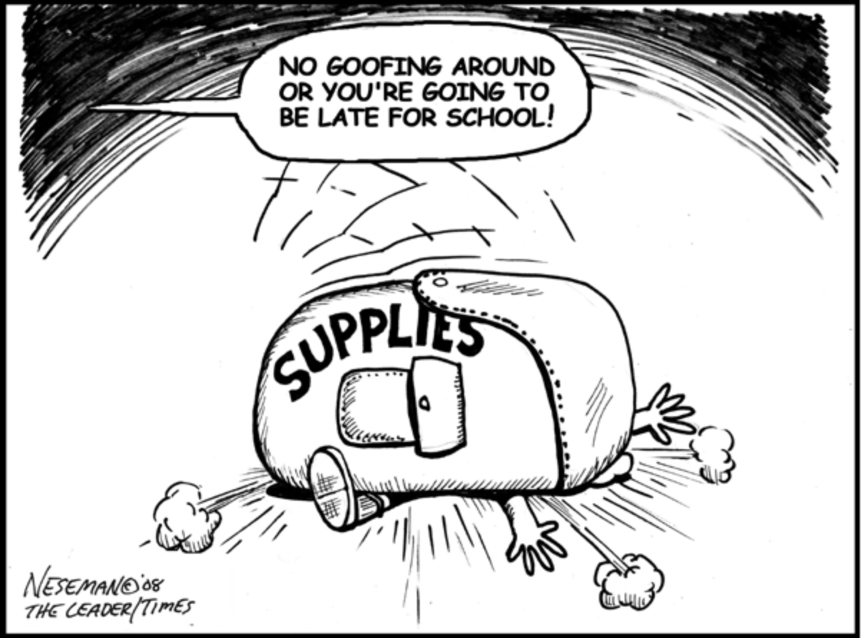
Ms. Andre Clear Lake High School 2019-2020
Grade Scale
How will I check my grade in class?
A+ | = 98-100% | A | = 94% - 97%
A- | = 90% - 93% | B+ | = 87% - 89%
B | = 84% - 86% | B- | = 80% - 83%
C+ | = 77% - 79% | C | = 74% - 76%
C- | = 70% - 73% | D | = 60% - 69%
F | = 0% - 59%
Class progress reports will be sent home every month. Parents and students are also strongly encouraged to check the Parent Portal on a weekly basis to view the most current grades for EVERY class.
What do I do if I am absent?
Always check google classroom site for handouts, and assignment due dates. A student has extra days to turn in any work assigned on a day a student was absent. If a quiz was administered on a day a student was absent, the quiz must be made up on the first day the student returns. If previously assigned work was due on the day of the absence, the work is due on the first day the student returns otherwise it is considered late and will only receive 70% credit.
How often will there be assessments and homework?
Homework will be given Monday- Thursday. Each assignment will be 10 points each and due at the beginning of the class period. Every assignment must include the proper heading or points will be deducted from the assignment
Grade Breakdown
Assessments / Quizzes = 50%
(vocabulary, reading comprehension, grammar)
Classwork/Homework = 50%
(graded on completeness & creativity)
Quizzes will be given every FRIDAY. Each quiz will have 4 questions and will be worth 20 points. Review your homework from the week to be prepared for the quiz. Notebooks/ binders will be checked Friday during the quiz.
Test will be given at the end of each chapter. Projected test dates are listed below but they may change depending on the pace of the course
Test Dates
Chapter 1: Basic Geometry | Sep 13 | Chapter 7: Transformations | Feb 7
Chapter 2: Reasoning and Proof | Oct 4 | Chapter 8: Similarity | Feb 28
Chapter 3: Perpendicular and Parallel Lines | Oct 25 | Chapter 9: Right Triangles and Trigonometry | March 20
Chapter 4: Congruent Triangles | Nov 22 | Chapter 10: Circles | April 3
Chapter 5: Properties of Triangles | Dec 6 | Chapter 11: Area and Polygons and Circles | May 1
Chapter 6: Quadrilaterals | Jan 24 | Chapter 12: Surface Area and Volume | May 15
Supplies
3 ring binder with 2-dividers
binder paper or notebook
graph paper
pencils
ruler
colored pencils or pen for correcting
nicoleandre@lakeport.k12.ca.us

Slide 3
Ms. Andre Clear Lake High School 2019-2020
PLEASE READ THE COURSE INFORMATION, SIGN, AND RETURN THIS SHEET TO MS. ANDRE.
Students:
Please sign below to signify that you have read the course sheet for Ms. Andre’s class, will keep it in your binder, and will be responsible for the information throughout the year, and will check Parent Portal at least once a week at school or at home.
_______________________________ _____________________________________________
Student printed name Student signature
Parents/Guardians:
Check all the statements that apply to how you would like to communicate with Ms. Andre about your student’s progress. I will email or call for major concerns or accomplishments, but with approximately 120 students, I like to know how you’d prefer to communicate.
_____ I/We have internet access at home, so we will check Parent Portal to check on my/our student’s progress. I/We will contact Ms. Andre about any concerns we have.
_____ I/We plan to email Ms. Andre weekly or monthly for an update.
_____ I/We do not have internet access at home, but I/we would like to have regular contact with Ms. Andre. I/we will call for an update on a regular basis.
_____ Other:
Please sign below to indicate that you have read the course sheet for Mrs. Andre’s class and that you will help your student be accountable for the information. If you have questions about the course or your
student’s work, please do not hesitate to contact me; email is the best way to reach me quickly. See the bottom of this sheet for my email address.
_______________________________ _____________________________________________
Parent/Guardian printed name Parent/Guardian signature
_______________________________ ______________________________________________
Parent/Guardian email Parent/Guardian daytime phone number
(please print)
Parents and guardians, please CIRCLE the best way for me to contact you:
e-mail phone
nicoleandre@lakeport.k12.ca.us

